Slide 1
Common Injuries
Sports Science

Slide 2
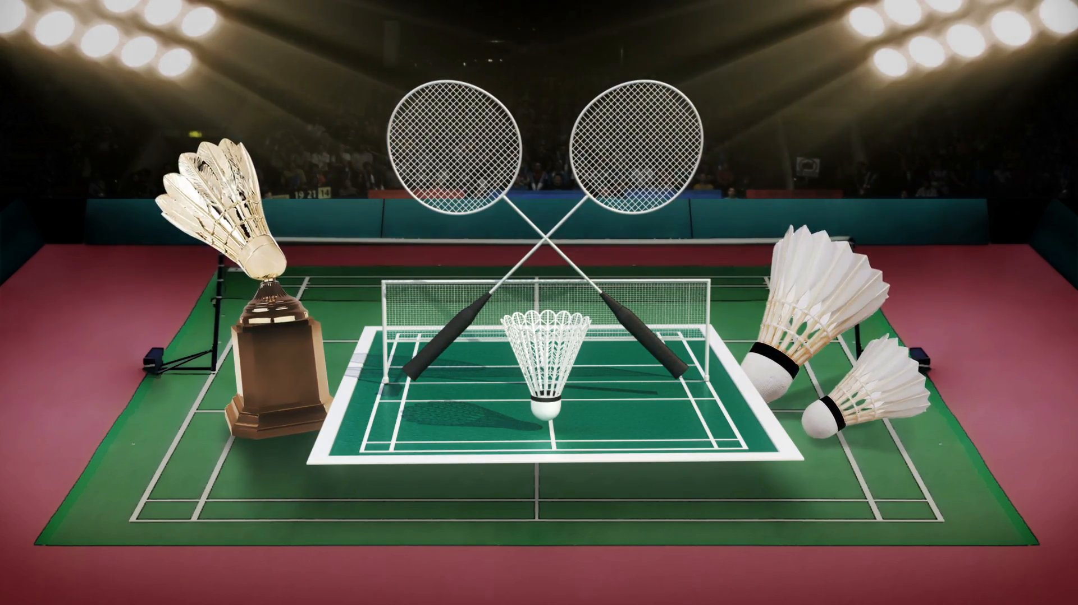
Badminton

Slide 3
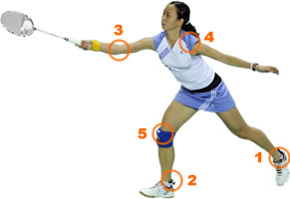
Common Injuries
Ankle Sprains
Jumper’s Knee
Rotator Cuff Injuries
Wrist Tendonitis
Wrist Strain

Slide 4
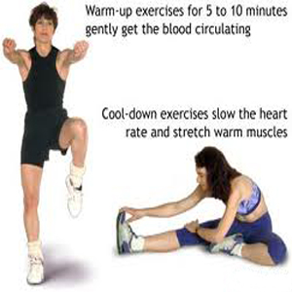
Prevention and Treatments
Warm Up
Cool Down
Sports Massage
Proper Equipments
Nutrition and Hydration

Slide 5

Instant treatment to injuries

